Slide 1
Methods in Java
Instructor Khurram Iqbal

Slide 2
Methods
A method is a collection of statements grouped together to perform an operation
Pre-defined Methods
Already defined in the Java class libraries known as standard library method or built-in method
println(), Math.pow(), input.nextInt(), etc.
User-defined Methods
The method written by the user or programmer
Modified as per requirement

Slide 3
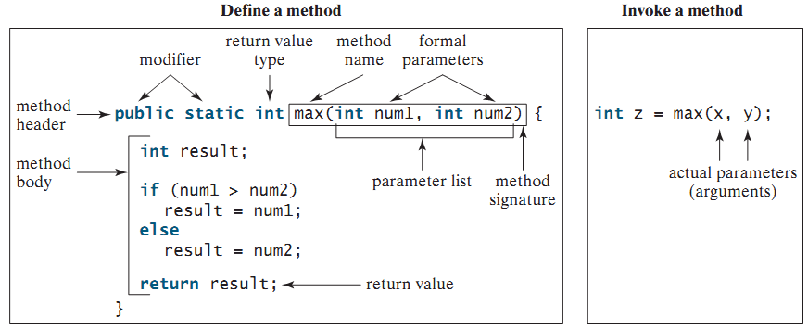
Defining a Method
Syntax
modifier returnValueType methodName(list of parameters) {
// Method body;
}

Slide 4
Defining a Method
Access Specifier:
It specifies the visibility of the method. Java provides four types of access specifier:
Public: The method is accessible by all classes
Private: The method is accessible only in the classes in which it is defined
Protected: The method is accessible within the same package or subclasses in a different package
Default: When we do not use any access specifier in the method declaration, Java uses default access specifier by default. It is visible only from the same package only.

Slide 5
Opening Problem
Find the sum of integers from 1 to 10, from 20 to 30, and from 35 to 45, respectively.

Slide 6
Problem
int sum = 0;
for (int i = 1; i <= 10; i++)
sum += i;
System.out.println("Sum from 1 to 10 is " + sum);
sum = 0;
for (int i = 20; i <= 30; i++)
sum += i;
System.out.println("Sum from 20 to 30 is " + sum);
sum = 0;
for (int i = 35; i <= 45; i++)
sum += i;
System.out.println("Sum from 35 to 45 is " + sum);

Slide 7
Problem
int sum = 0;
for (int i = 1; i <= 10; i++)
sum += i;
System.out.println("Sum from 1 to 10 is " + sum);
sum = 0;
for (int i = 20; i <= 30; i++)
sum += i;
System.out.println("Sum from 20 to 30 is " + sum);
sum = 0;
for (int i = 35; i <= 45; i++)
sum += i;
System.out.println("Sum from 35 to 45 is " + sum);

Slide 8
Solution
public static int sum(int i1, int i2) {
int sum = 0;
for (int i = i1; i <= i2; i++)
sum += i;
return sum;
}
public static void main(String[] args) {
System.out.println("Sum from 1 to 10 is " + sum(1, 10));
System.out.println("Sum from 20 to 30 is " + sum(20, 30));
System.out.println("Sum from 35 to 45 is " + sum(35, 45));
}

Slide 9
Method Signature
Method signature is the combination of the method name and the parameter list.

Slide 10
Formal Parameters
The variables defined in the method header are known as formal parameters.

Slide 11
Actual Parameters
When a method is invoked, you pass a value to the parameter. This value is referred to as actual parameter or argument.

Slide 12
Return Value Type
A method may return a value. The returnValueType is the data type of the value the method returns. If the method does not return a value, the returnValueType is the keyword void. For example, the returnValueType in the main method is void.

Slide 13
Naming a Method
Single-word method name: sum(), area()
Multi-word method name: areaOfCircle(), stringComparision()
It is also possible that a method has the same name as another method name in the same class, it is known as method overloading.

Slide 14
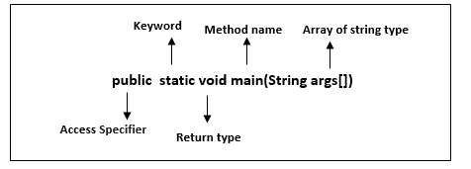
Java main() method
The main() is the starting point for JVM to start execution of a Java program
public:
JVM can identify the execution point of the program. If we use private, protected, and default before the main() method, it will not be visible to JVM
static:
Static methods are the method which invokes without creating the objects, so we do not need any object to call the main() method.
String args[]:
The main() method also accepts some data from the user. It accepts a group of strings, which is called a string array. It is used to hold the command line arguments in the form of string values.
main():
It is a default signature which is predefined in the JVM. It is called by JVM to execute a program line by line and end the execution after completion of this method. We can also overload the main() method.
void:
Void keyword acknowledges the compiler that main() method does not return any value.

Slide 15
Java main() method
What happens if the main() method is written without String args[]?
The program will compile, but not run, because JVM will not recognize the main() method
JVM always looks for the main() method with a string type array as a parameter.
Execution Process
First, JVM executes the static block
Then it executes static methods
Then it creates the object needed by the program
Finally, it executes the instance methods
public static void main(String[] args){
System.out.println("Hello");
}
static //static block
{
System.out.println("Static block");
}

Slide 16
Different way to write main()
public static void main(String args[])
static public void main(String args[])
static public void main(String[] x)
static public void main(String []x)
static public void main(String...args)

Slide 17
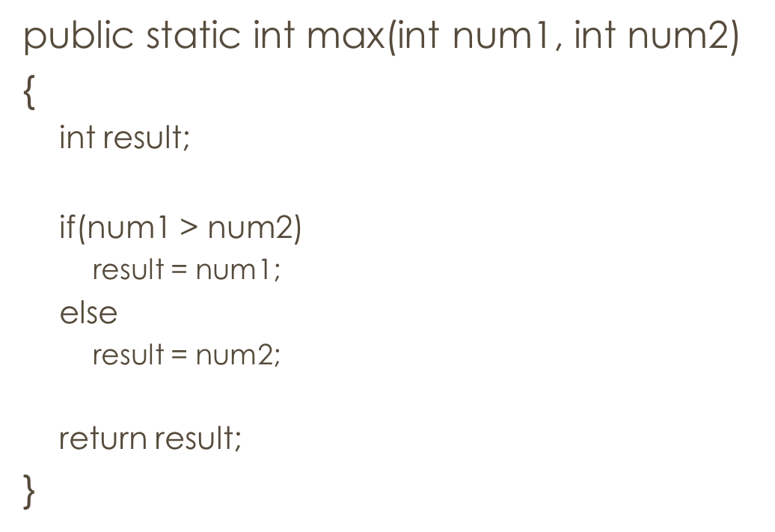
Calling a Method
Calling a method executes the code in the method
Method definition: indicates what the method does
How to call a method?
Value returning method: a call to the method is treated as a value
int larger = max(3, 4);
or System.out.println(max(3, 4));
Void method: a call to the method must be a statement
System.out.println(“Hello”);

Slide 18
Calling a Method
When a program calls a method, program control is transferred to the called method
How is the control returned?
return statement is executed OR
Ending closing brace ( } )is reached

Slide 19
Using/reusing a method
public class TestMax {
/* main method */
public static void main(String[] args){
int i = 5;
int j = 2;
int k = max(i, j);
System.out.println("The max of " + i + " and " + j + " is " + k);
}
/* Returns the maximum of two numbers */
public static int max(int num1, int num2){
int result;
if(num1 > num2)
result = num1;
else
result = num2;
return result;
}
}
i j k num1 num2 result
5
2
5
2
undefined
5
5
The max of 5 and 2 is 5
Reusing a static method: Classname.methodName
Reusing max(): TestMax.max

Slide 20
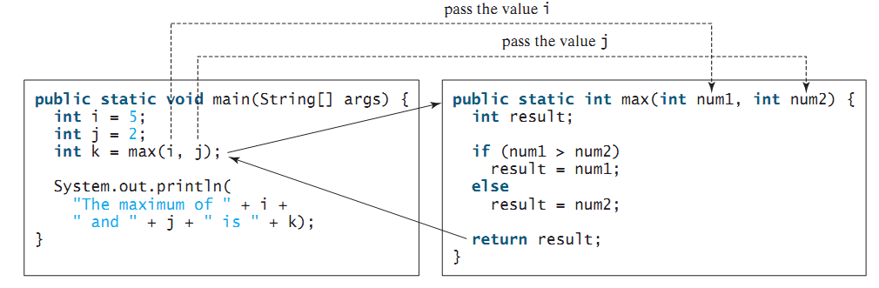
Calling a Method

Slide 21
Activation record & call stack
Each time a method is invoked, the system creates an activation record, a.k.a activation frame
Stores parameters and variables for the method
The system places the record in an area of memory known as a call stack (a.k.a execution stack, runtime stack, machine stack, or just stack)
Information is stored in a last-in, first-out fashion
When a method calls another method, the caller’s activation record is kept intact, and a new activation record is created for the called method
When the called method finishes its work and returns to its caller, its activation record is removed from the call stack

Slide 22
Call stack: example
public class TestMax {
/* main method */
public static void main(String[] args){
int i = 5;
int j = 2;
int k = max(i, j);
System.out.println("The max of " + i + " and " + j + " is " + k);
}
/* Returns the maximum of two numbers */
public static int max(int num1, int num2){
int result;
if(num1 > num2)
result = num1;
else
result = num2;
return result;
}
}
Activation record for max method
result:
num2: 2
num1: 5
Activation record for max method
result: 5
num2: 2
num1: 5
Activation record for main method
k :
j : 2
i : 5
Activation record for main method
k :
j : 2
i : 5
Activation record for main method
k : 5
j : 2
i : 5
Stack is empty

Slide 23
Void method
A void method does not return a value.
No return statement is used; ending brace returns the control to the caller method

Slide 24
Void method with return

Slide 25
Passing arguments by values
The arguments are passed by value to parameters when invoking a method (pass-by-value)
If the argument is a variable, the value of the variable is passed to the parameter
Parameter order association
Arguments must be in the same order as their respective parameters in the method signature
Example:
nPrintln(“Hi”, 3);
nPrintln(3, “Hi”);
nPrintln(“Hi”, ‘3’);

Slide 26
Pass-by-value (example 1)

Slide 27
Pass-by-value (example 2)
What will happen if we change the parameter name n1 in swap method to num1?

Slide 28
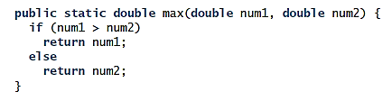
Overloading methods
Overloading the methods enables their redefinition with the same name
Signatures of overloaded methods must be different
Different number or type of parameters
double larger = max(12.3, 15.7);
int larger = max(10, 5);

Slide 29
max(2, 2.5); ????
Which max method will be invoked?
Why max(double, double) is not invoked for the call max(3, 4)?

Slide 30
Ambiguous invocation of overloaded method
Two or more possible matches for the invocation
Best match cannot be determined
Generates a compiler error

Slide 31
Scope of variables
The scope of a variable is the portion of the program where it can be referenced
Local variable: a variable defined inside a method
Scope starts from its declaration; continues to the end of the block
Must be declared and assigned a value before its use
Method-level scope
Parameter is a local variable: scope is within the entire method body
Variables inside a method have method level scope
Block-level scope
A variable declared in header of a for-loop can be referenced in the entire loop
A variable declared inside for-loop’s body has its scope after declaration till the end of loop

Slide 32
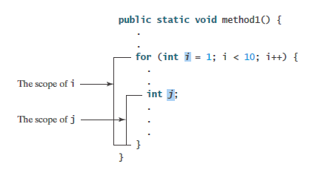
public class Test {
public static void main(String[] args){
int x = 5;
System.out.println(x);
System.out.println(y);
}
public static void Method1(){
int x = 1;
int y = 10;
System.out.println(y);
System.out.println(z);
}
public static void Method2(){
int x = 13;
int y = 12;
int z = 5;
System.out.println(x);
System.out.println(y);
}
}

Slide 33
Scope of variables
A common mistake

Slide 34
Summary
Method definition & calling
Value returning method & void method
The call stack
Transfer of control
Pass-by-value (argument passing)
Method overloading
The scope of variables

